Slide 1
Workshop - AI: Azure Machine Learning MLOps In a Day
Introduction to MLOps

Slide 2
Disclaimer

Slide 3
Learning Units covered in this Module
Introduction to MLOps
Building Blocks for MLOps
MLOps Maturity

Slide 4
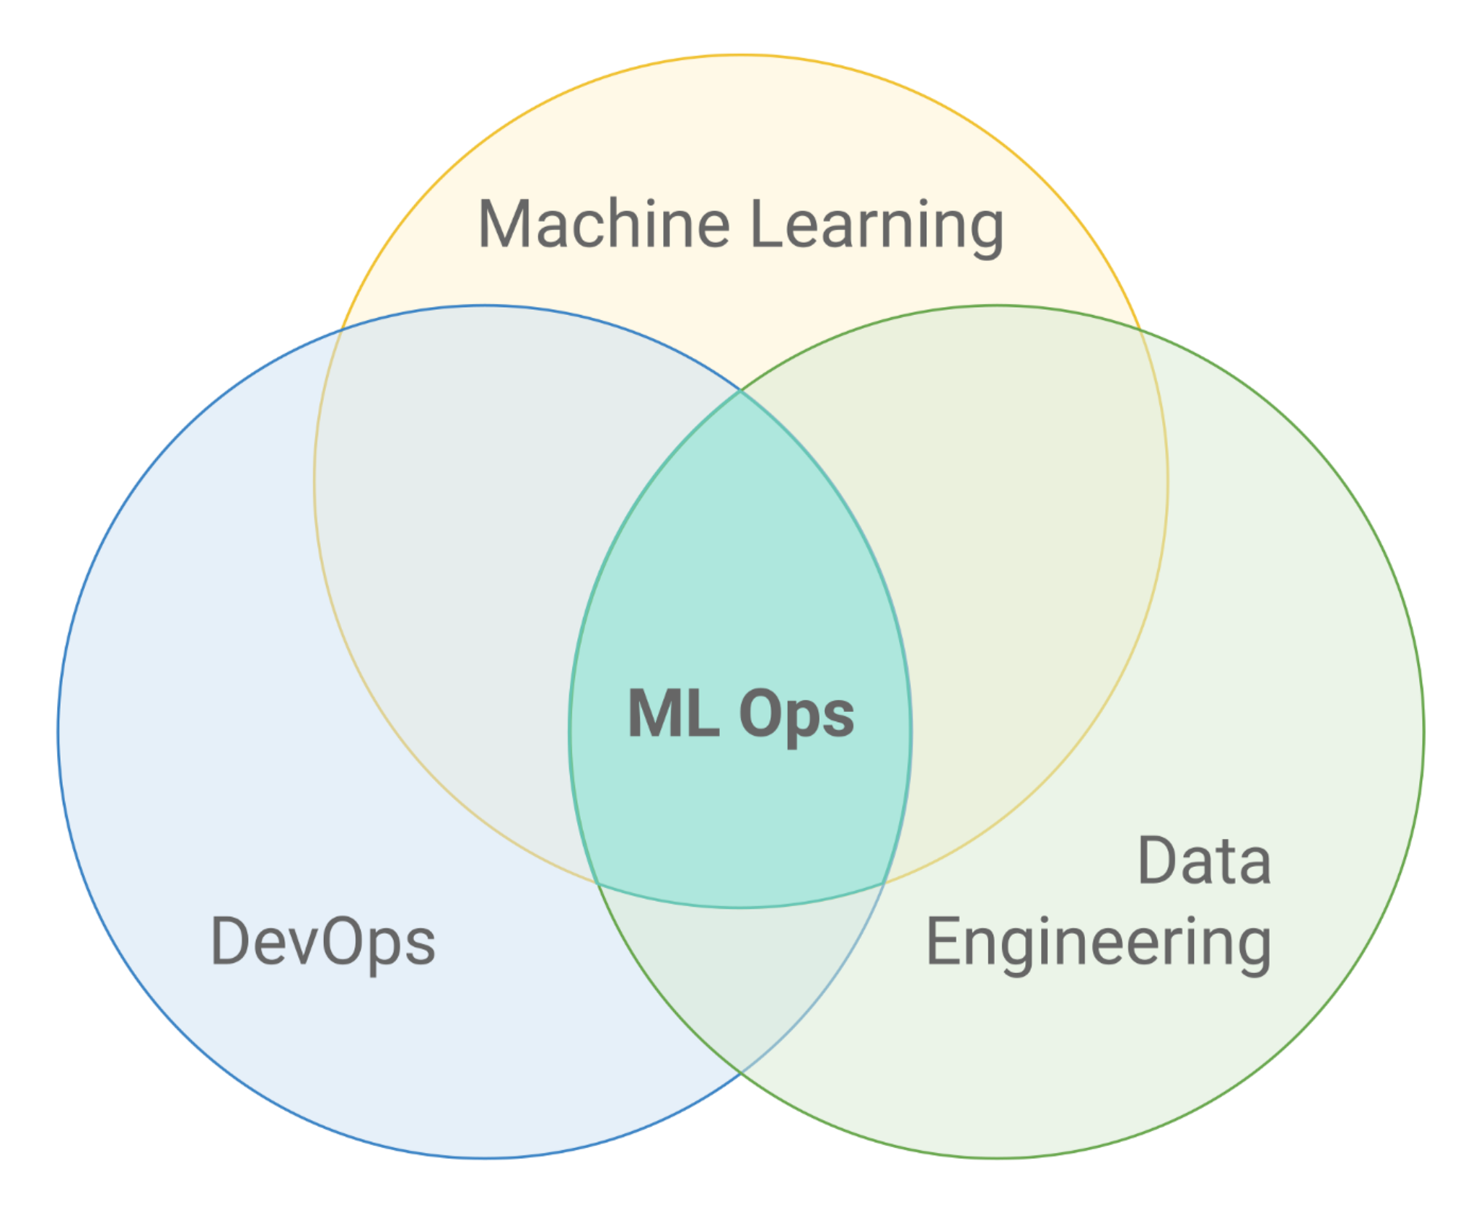
MLOps
"ML Ops: Machine Learning as an Engineering Discipline"
"MLOps or ML Ops is a set of practices that aims to deploy and maintain machine learning models in production reliably and efficiently"
Notes:
MLOps is practiced between Data Scientists, DevOps, and Machine Learning engineers to transfer the trained model to production systems to serve. Similar to DevOps or DataOps approaches, MLOps seeks to increase automation and improve the quality of production models, while also focusing on business and regulatory requirements. While MLOps started as a set of best practices, it is slowly evolving into an independent approach to ML lifecycle management. MLOps applies to the entire lifecycle - from integrating with model, orchestration, and deployment, for monitoring, diagnostics, governance, and business metrics.
According to Gartner, MLOps is a subset of ModelOps. MLOps is focused on the operationalization of machine learning models, while ModelOps covers the operationalization of all types of AI models.

Slide 5
MLOps Benefits
Faster time to market of ML-based solutions
More rapid rate of experimentation, driving innovation
Assurance of quality, trustworthiness and ethical AI

Slide 6
MLOps Core Principles
Data and Services
Agile Best Practices
Automation
Manage Infrastructure Resources
Notes:
• Connect Data and Services – DevOps success depends on how well platforms of data and existing/new services can be integrated, adapting to changing circumstances.
• Automation – Automation needs to be considered in the context of the above, to ensure constant, consistent, and efficient delivery of business value.
• Manage Infrastructure Resources – Applications will be deployed to an increasingly commoditized, flexible, target environment of infrastructure and platform-level services.

Slide 7
MLOps Goal
Reproducibility
Reusability
Manageability
Automation
Notes:
Reproducibility – as with software configuration management and continuous integration, ML pipelines and steps, together with their data sources, code, models, libraries, and SDKs, need to be versioned and maintained such that they can be reproduced exactly as previously.
Reusability – to fit with principles of continuous delivery, the pipeline needs to be able to package and deliver models and code consistently into training and target environments, such that the same configuration can be repeated with the same results.
Manageability – the ability to apply governance, tracking changes to models and code throughout the development lifecycle, project tracking (for example through sprints), and enabling managers to measure and oversee both progress and valuedelivery.
Automation – as with DevOps, continuous integration and delivery require automation to assure rapid and repeatable pipelines, particularly when these are augmented by governance and testing (which can otherwise create a bottleneck).

Slide 8
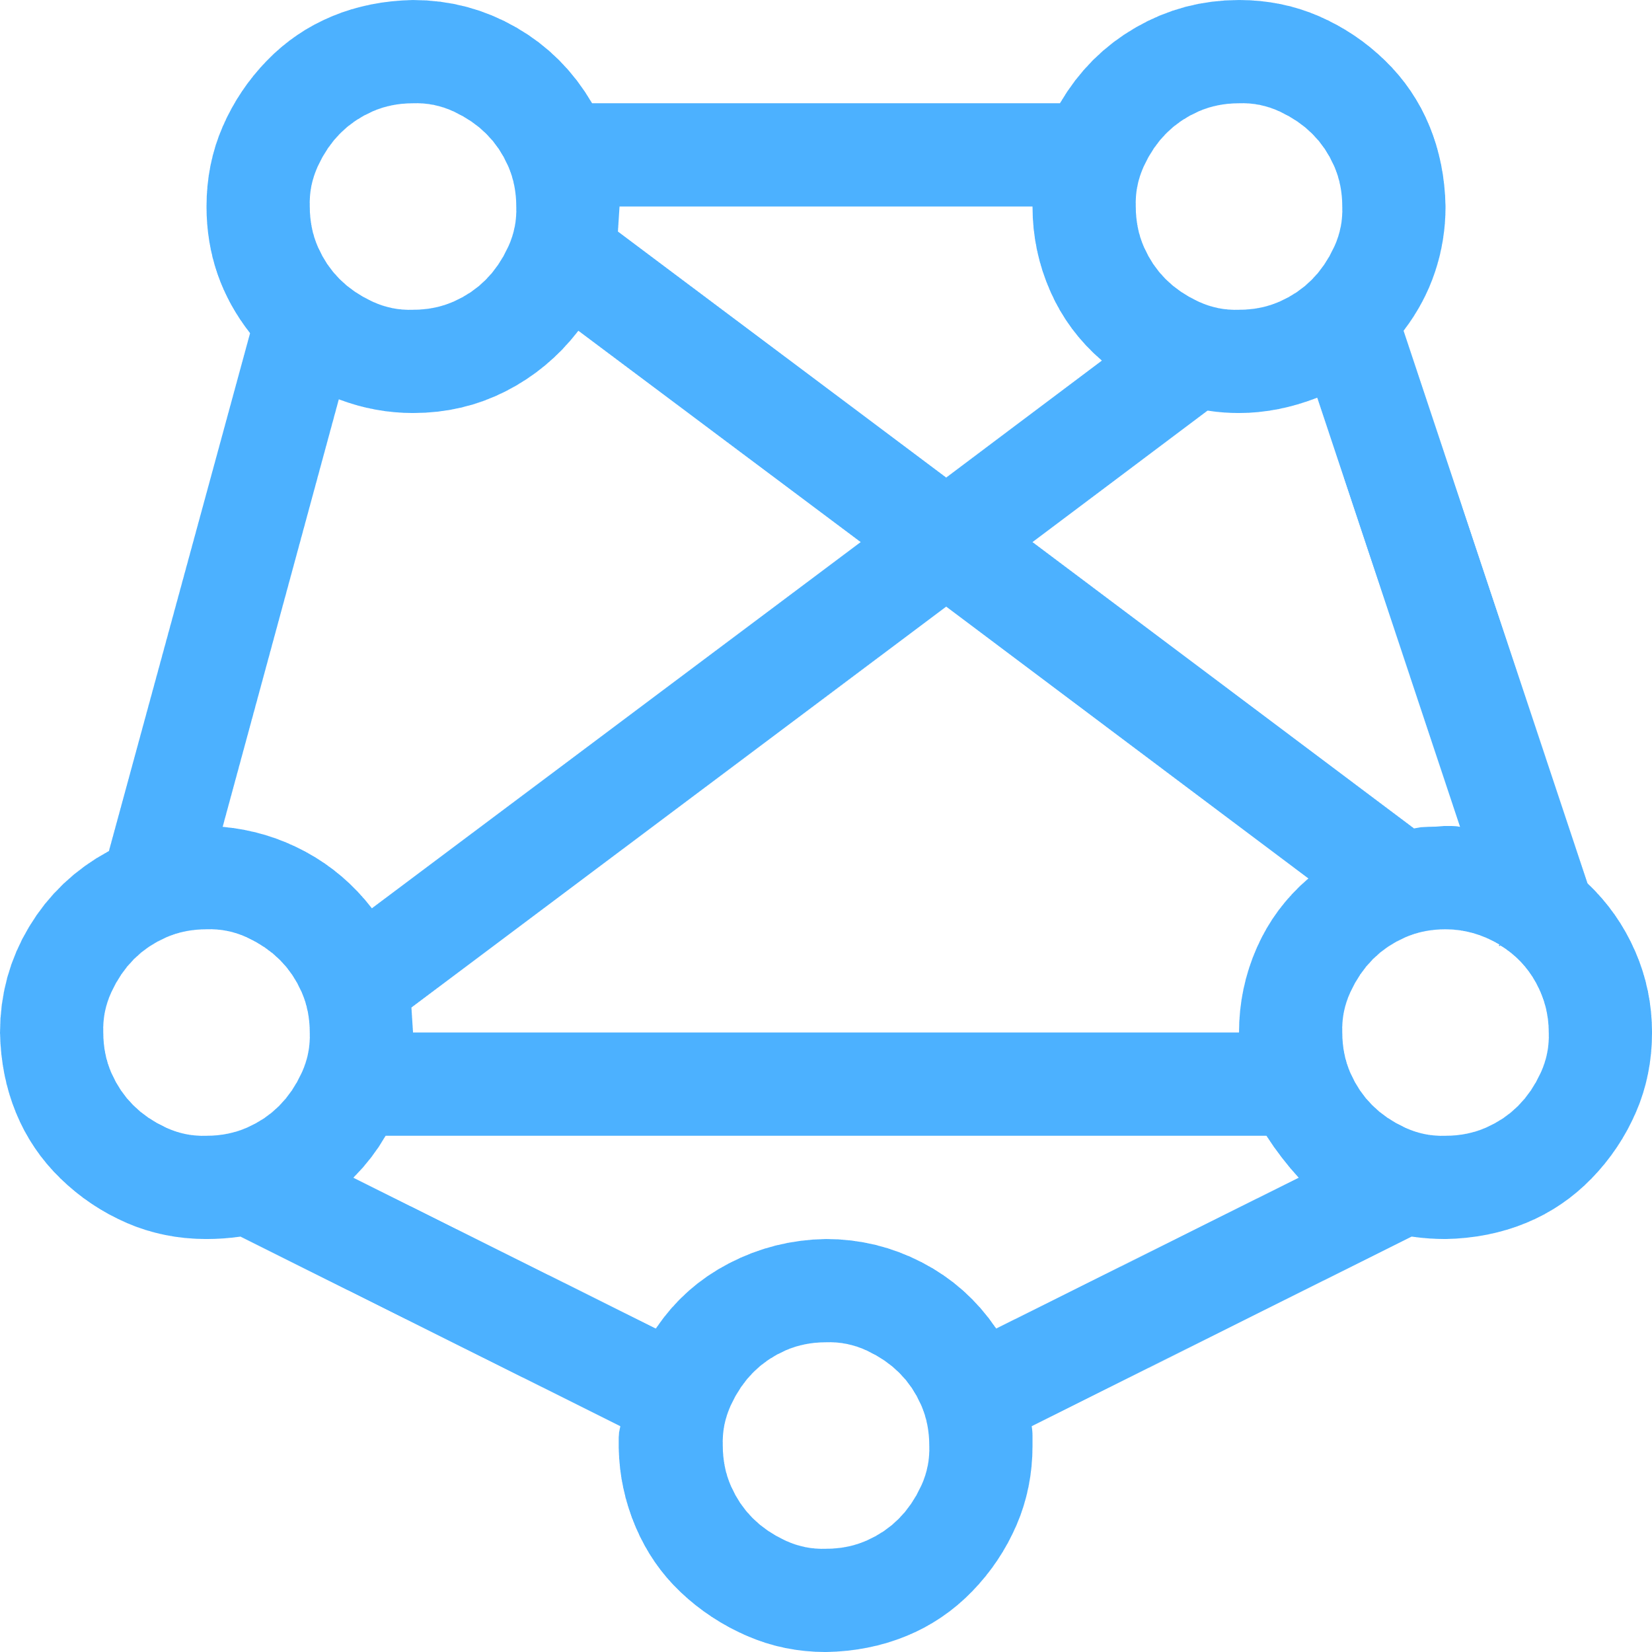
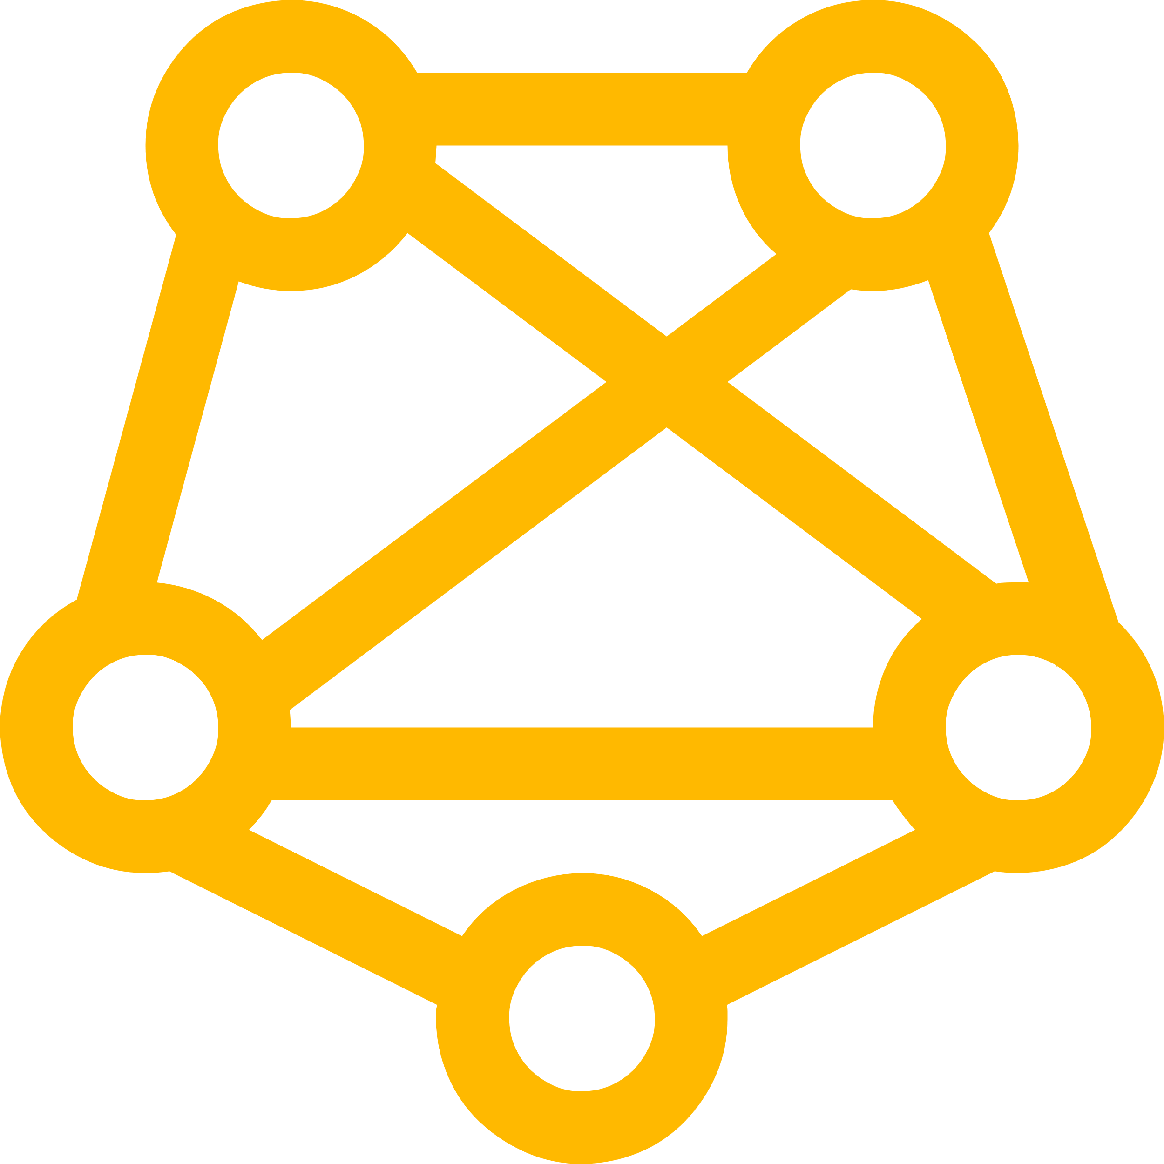
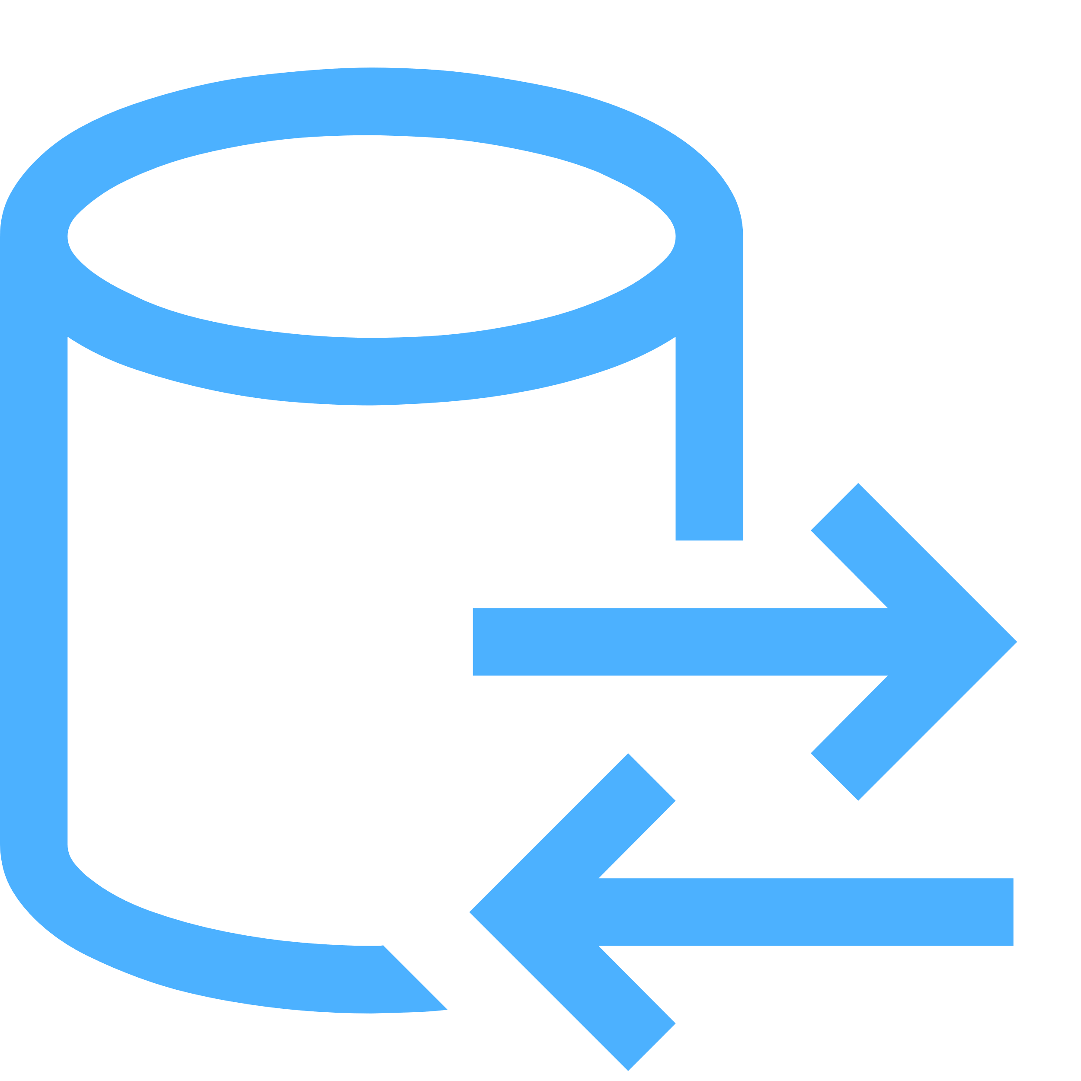
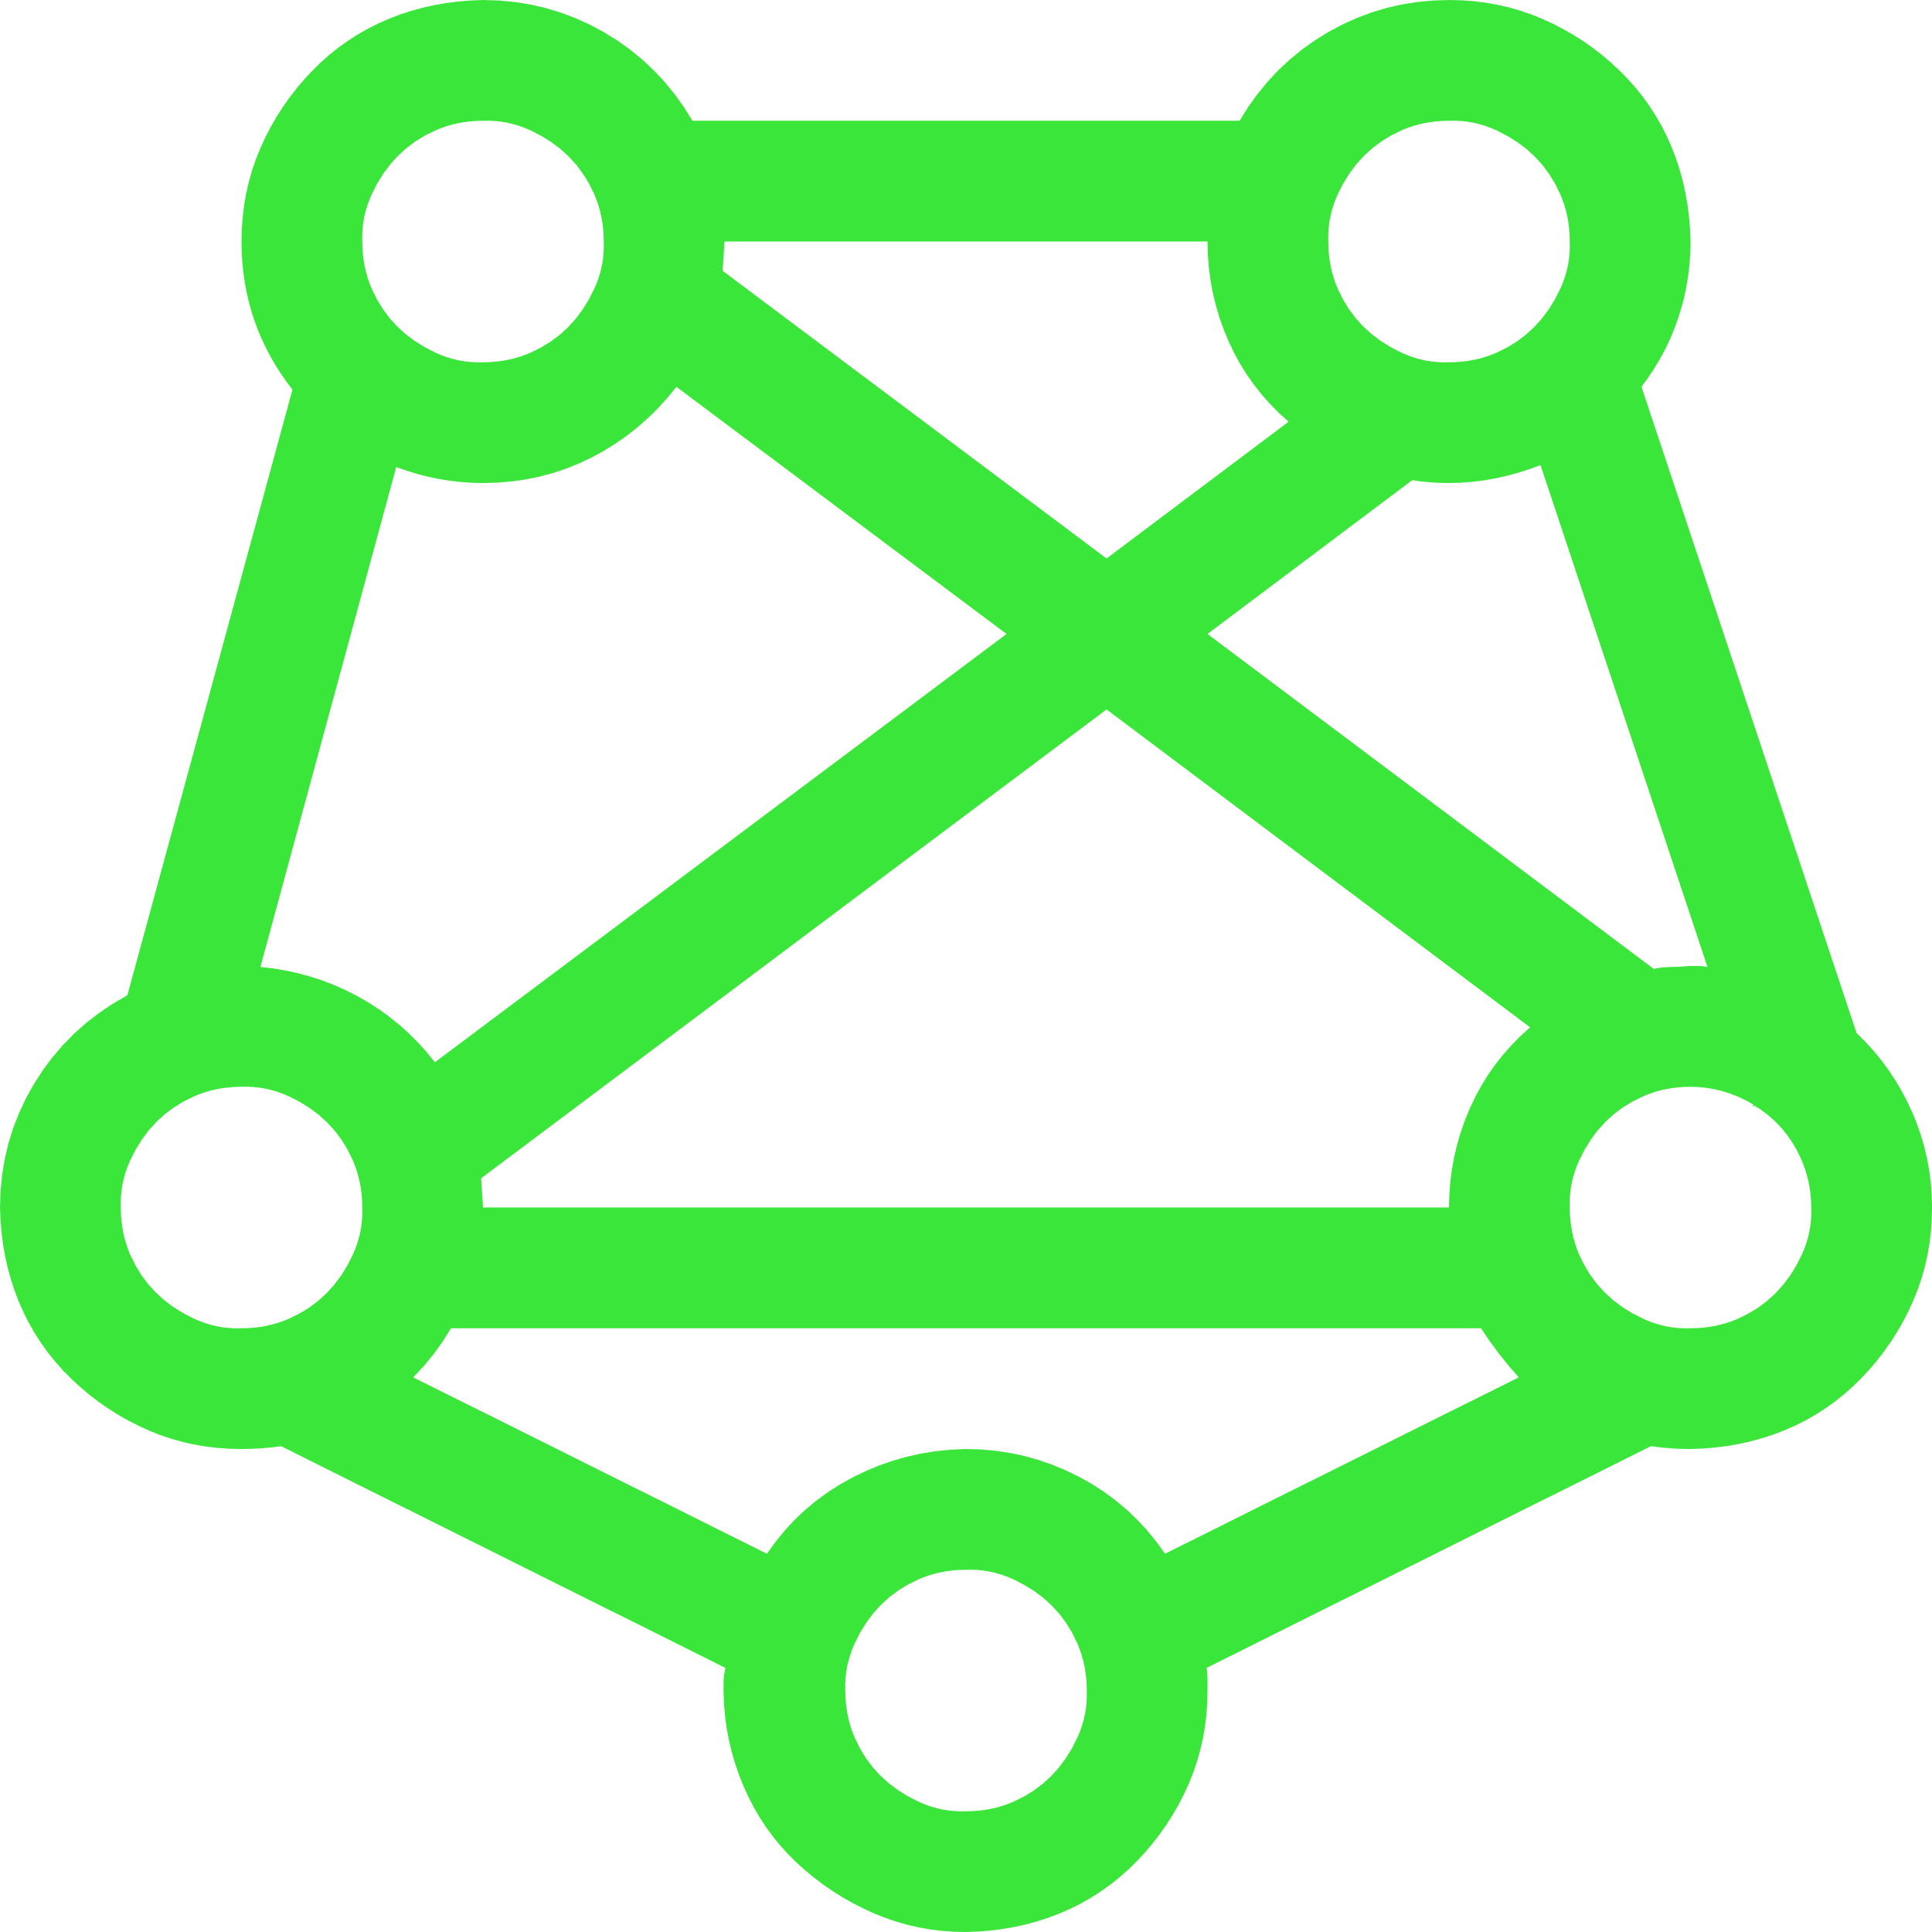


MLOps in Practice
Train Model
Evaluate and choose best Model
Deploy Model
Monitor Model
Retrain Model

Slide 9
ML Model Management Challenges
Machine Learning Model Management
Model Validation
Lack of abstraction for the whole ML Pipeline
Querying Model Metadata
Multi-Language Smell
Backwards Compatibility of Trained Models
Notes:
Here we highlight some of model management challenges.
First challenge is Machine Learning Model Management, which considers how we manage model parameters / weights.
Second, there is mode validation, the ability to able back-test the performance of models over time. Models evolve over time as data changes, hardware improvement or algorithm changes. Every time such a change happens, model needs to be retrained and model performance must be re-validated. These validations introduce a number of challenges for example using the same code and same data across different models to be able to reproduce the same result.
In real-world, there are cases where different systems need to be “glued” together in ML deployments, and often require external orchestration frameworks that coordinate the workloads. This situation has big negative impact for model management tasks: It complicates the extraction of metadata corresponding to a particular pipeline it makes reproduciability and automation of model selection difficult as many different systems have to be orchestrated, and as a consequence makes it hard to automate model validation.
In order to automate and accelerate model lifecycle management, it is important to query metadata like hyperparameters, evaluation scores as well as the datasets on which they were trained and validated). This metadata is required during models selection in order to decide which one to put into production, or for getting a review on training progress, or for identifying bottleneck so we can decide where we want to spend more time finetuning our model. Additionally, a centralized metadata store builds a fundation for a more efficient process in enterprise solution and can also be used to automate some steps or processes.
Another hard challenge in model management is called “Multiple-Language Smell”, it comes from the fact that end-to-end ML applications often written in different programming languages with different frameworks. Many popular libraries are written in python with different frameworks. It’s hard to keep heterogeneous code consistent as automatic tools tools can only inspect either the python or the JVM part of the code, and will not be able go across the language barrier. To make things even worse, this makes it even harder to deploy at later time, as they require setups with many different components that need to be orchestrated. For example., a Spark cluster must be started and running for pre-processing or feature engineering, afterwards the data might need be moved to a another virtual machine for model training, and the cluster must be shut down afterwards, we will then need another virtual machine to run inference. This raises the challenge of how to efficient and reliable exchange of code, data and model between the different components of the system written in different languages and different frameworks.
All trained models require backwards compatibility. For example, a model that was trained last month or last quarter should still be working today, in particular when trained models might be used in production deployments.In the meantime, we also want to reproduce the exact same result, or a similar result can be achieved, or in the worst case that the model can still run. Ensuring these conditions comes with several challenges on model management.For example, when a model is deployed and served in production, making sure that the exact same result sometime can be retrieved is a strict requirement. According to this, storing all the components that trained a model is fundamental piece in being able to guarantee backwards compatibility and long-term usage. We need to store the data , data transformations, the code implementation, the inference code of calling the model, its configuration and its dependencies in details

Slide 10
MLOps Terms
Pipeline
Data Store
DataSet
Repository
Model
Model Registry
Workspace
Notes:
• Pipeline – An ML-based application will follow a planned and automated series of steps. The pipeline itself can be put under configuration control, such that the steps can be reused.
• Datasets store/Datasets – MLOps relies on an easily accessible and scalable source of data, both during training and inference. While data may come from several sources, it will be prepared, cleaned, and accessed as a single resource.
• Repository – A common, version-controlled storage resource (e.g. Git) for data, model, and configuration schemas, managing dependencies between models, libraries, and other resources.
• Model Registry – A logical picture of all elements required to support a given ML model, across its development and operational pipeline.
• Workspace – Model and application developers conduct their activities collaboratively using shared workspaces, accessible graphically or via code (e.g. written in Python), with access control over data sets, models, and insights.
• Target Environment – A deployment environment for ML models and code, packaged, for example, as containers/microservices, which is often cloud-based but can include on-premises and edge-based environments.
• Experiment – An activity sequence that enables a hypothesis to be tested and validated iteratively. Outputs of a given iteration need to be stored so they can be assessed, compared, and monitored for audit purposes.
• Model – Packaged output of an experiment that can be used to predict values or built on top of (via transfer learning).

Slide 11
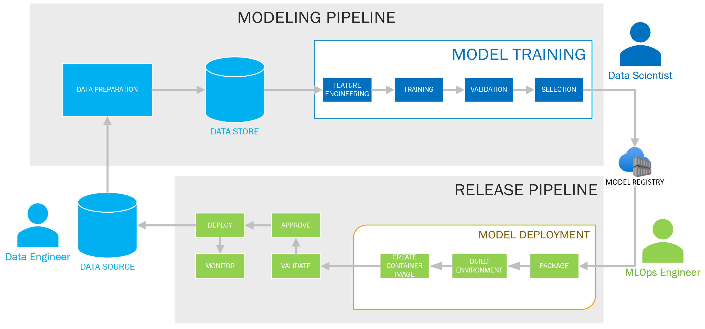
MLOps and Roles

Slide 12
MLOps Maturity
Level | Automated Training | Automated Deployment | Central Repository for Model Training and Model Registry
No MLOps
Automated Training | X |  | X
Automated Deployment |  | X | X
Full Automation | X | X | X
Azure ML Pipeline
Azure ML Model Registry / Container Registry
Azure ML Workspace
Notes:
The purpose of this maturity model is to help clarify the Machine Learning Operations (MLOps) principles and practices. The maturity model shows the continuous improvement in the creation and operation of a production level machine learning application environment. You can use it as a metric for establishing the progressive requirements needed to measure the maturity of a machine learning production environment and its associated processes.

Slide 13
Azure Machine Learning Environment

